Slide 1

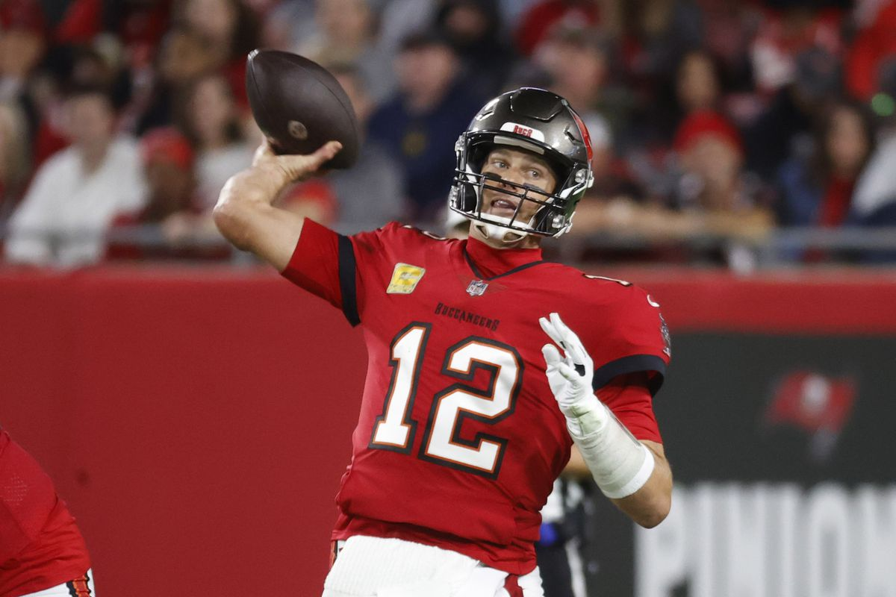
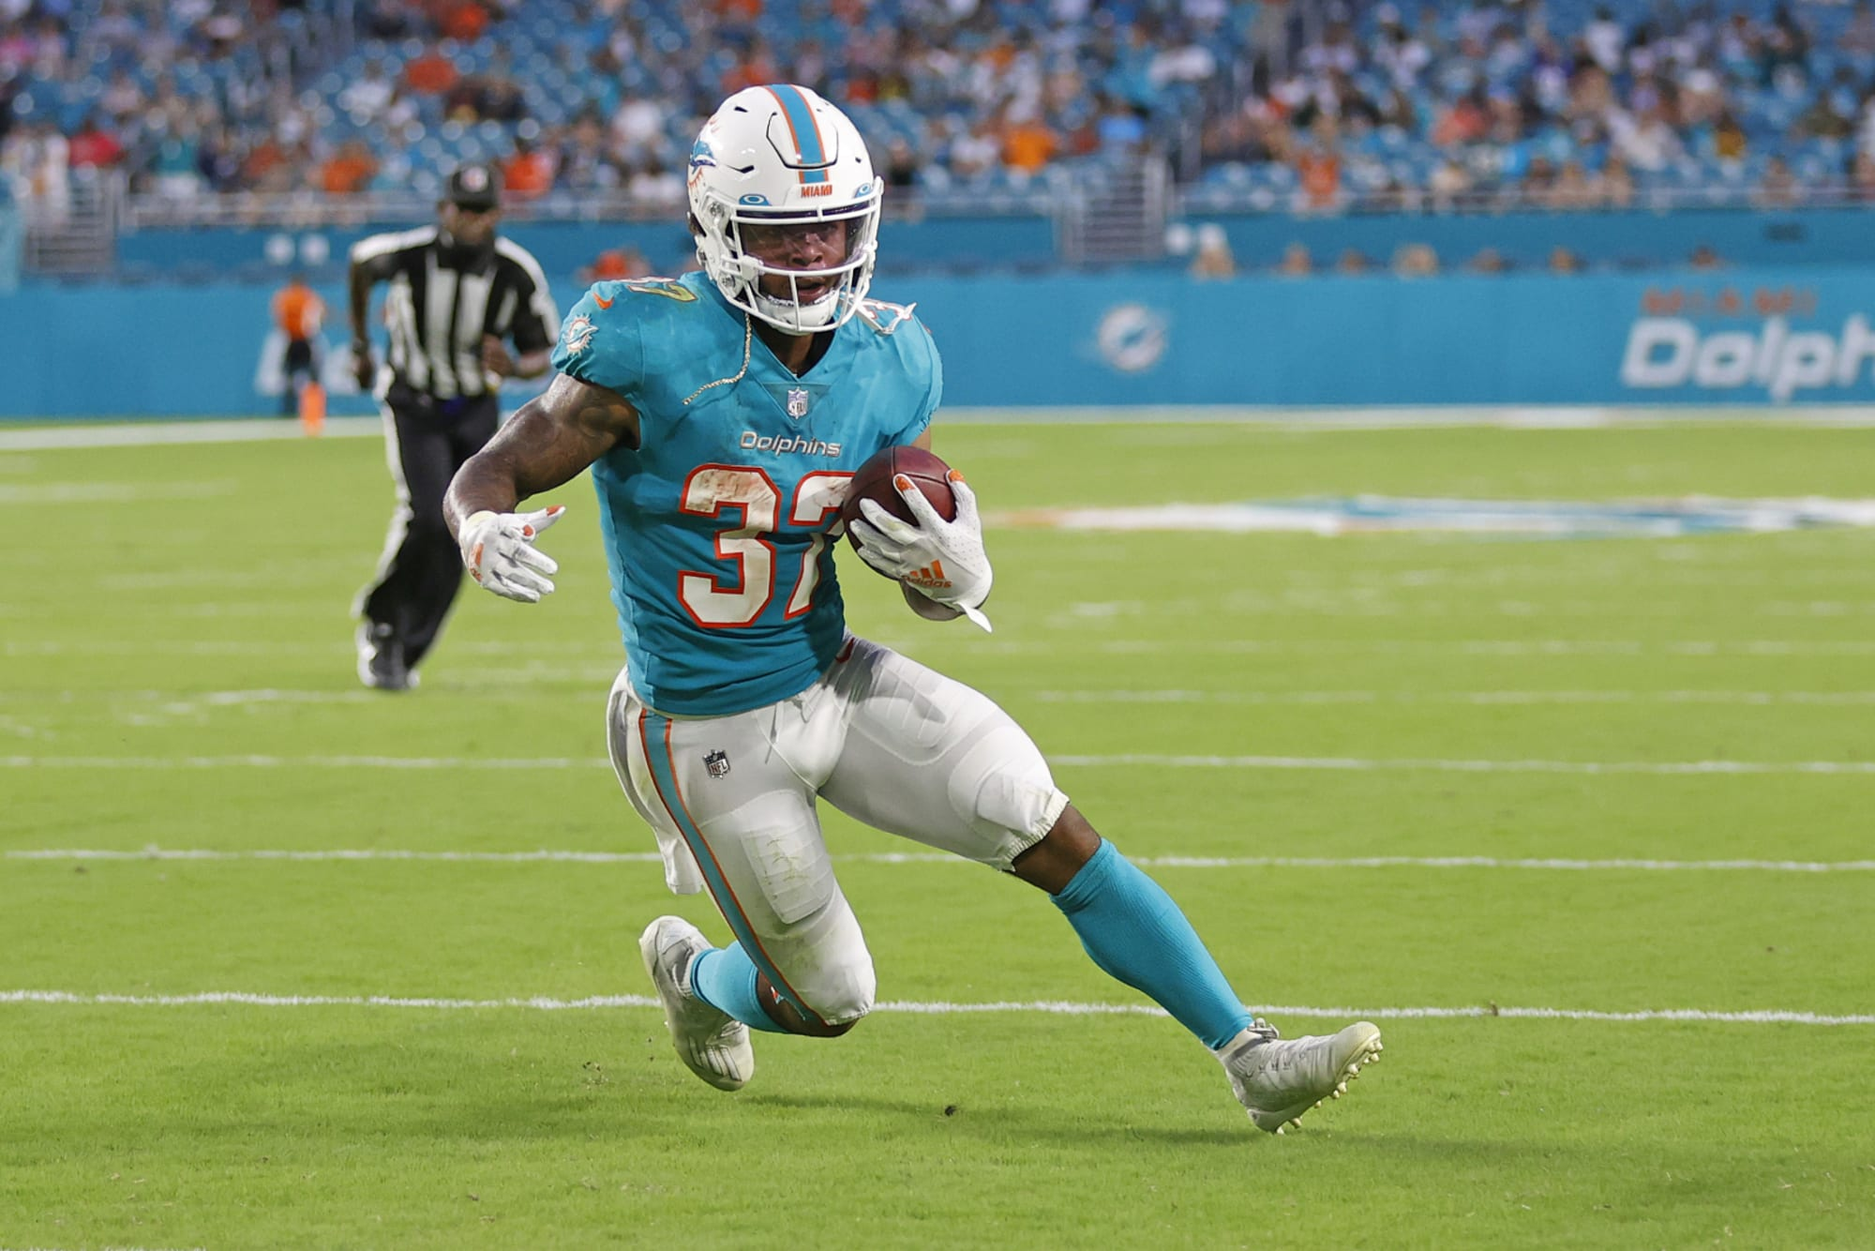
NFL Football Play Predictor
Brendan Laney
EEE-4773/5776 Machine Learning
Fall 2021

Slide 2
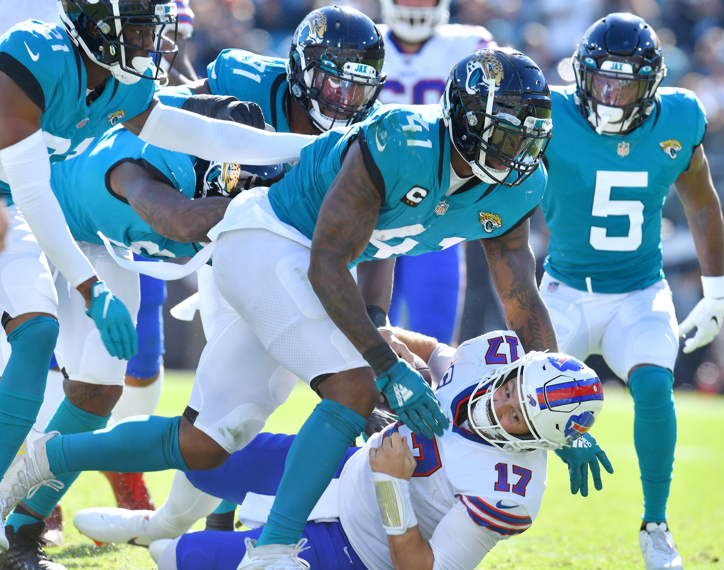
Outline of Presentation
Introduction
Brief Football Summary
Data
Interpreting Data
Decision Trees
Results
Conclusion
Future Works

Slide 3
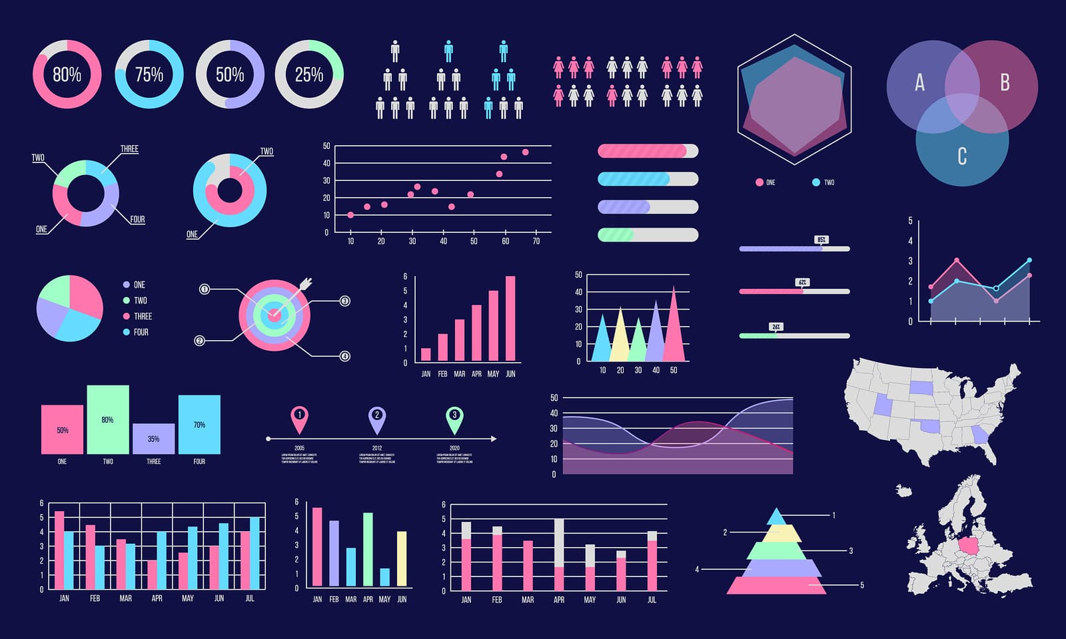
Introduction
Predict NFL football plays
Read play-by-play data from .csv file
Train data
Test data
Use decision tree to obtain results

Slide 4
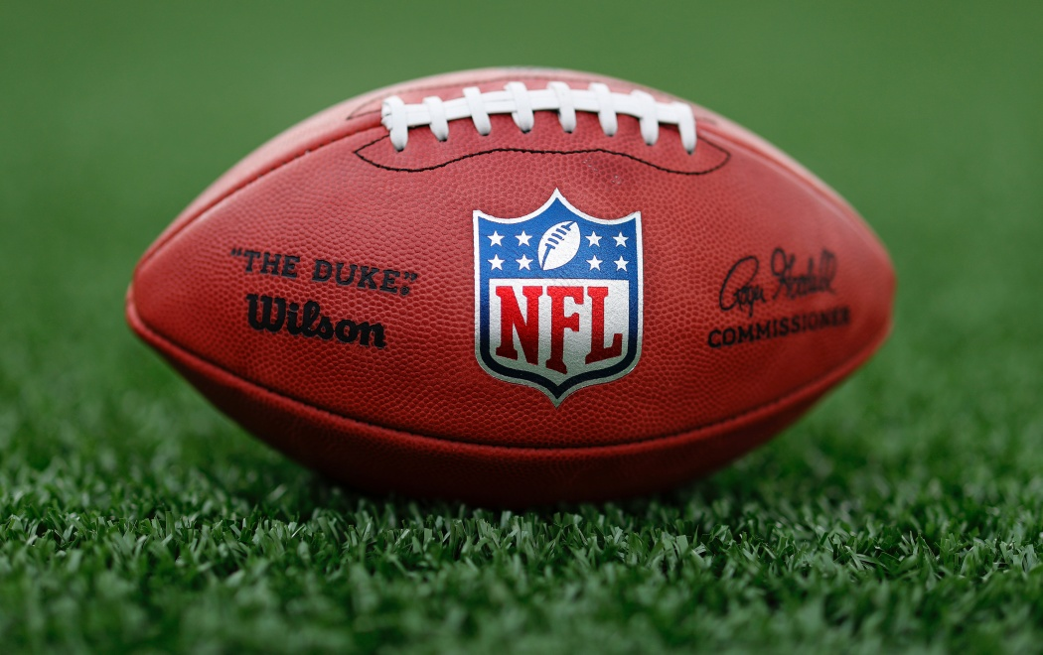
Brief Football Summary
Multiple components of football game
  Offense
  Defense
  Special Teams
Focused on predicting offensive plays
  Pass
  Run

Slide 5
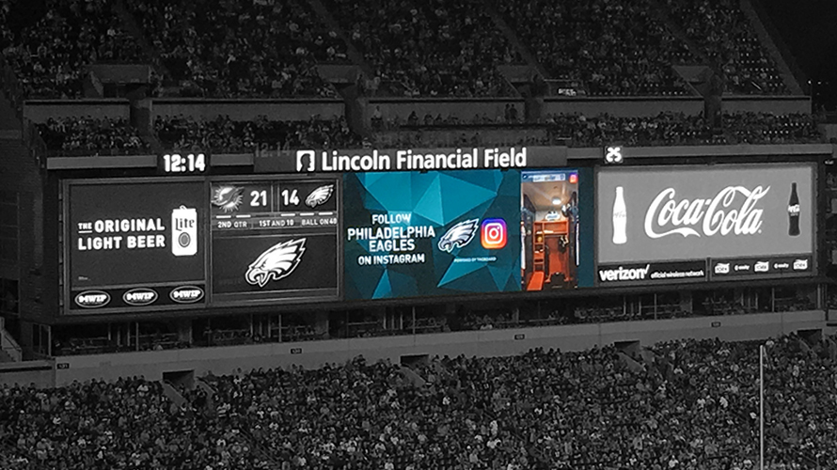
Data
Down of the drive
Quarter of the game
Score of game
Yards to go until 1st down or score
Time remaining in the game/half
Field position

Slide 6
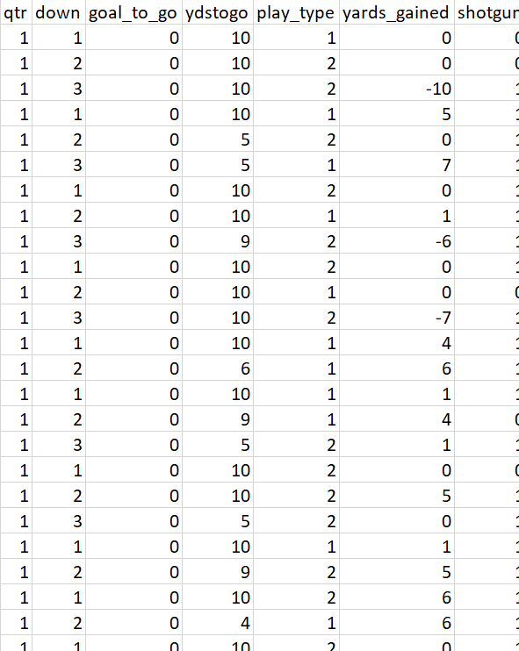
Interpreting Data
Play-by-play data used which details everything about every single play during the 2019 season
Organize the data
  Convert run plays = 1, pass plays = 2
  Remove unnecessary data
    Defensive stats
    Fourth downs, kickoffs

Slide 7
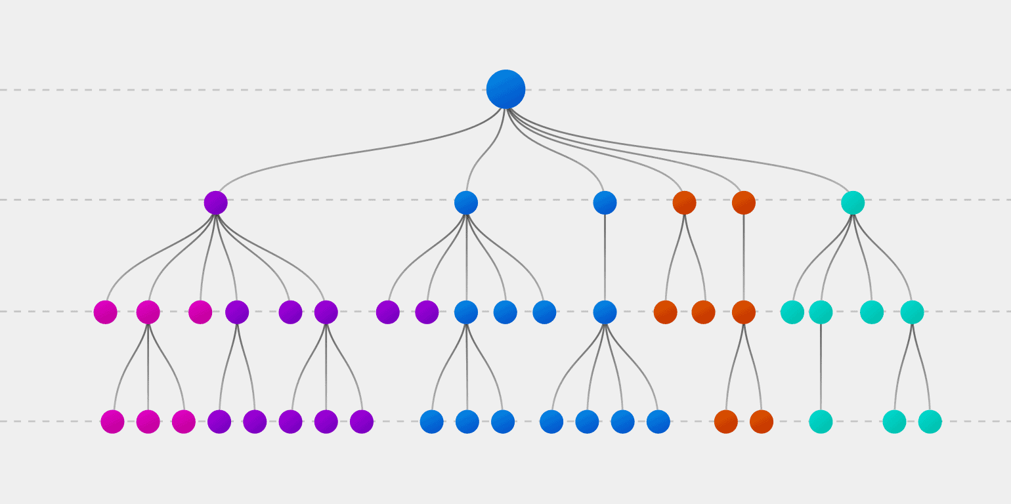
Decision Trees
Supervised and classification problem
  Learn from data source
  Make choice whether the play is a run or a pass

Slide 8
Results
Trained data only using down, quarter, score differential, and yards to go
  Time remaining in game/half and field position negatively impacted prediction accuracy
70% data trained
30% data tested
Resulted in prediction accuracy of ≈65%

Slide 9
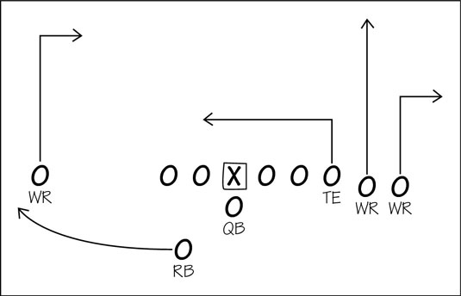
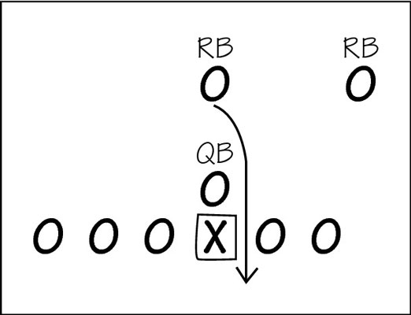
Conclusion
Designed NFL play predictor
Obtaining and interpreting quality data is crucial
Decision trees

Slide 10
Future Works
NFL teams change drastically during offseason
  One team this year is not necessarily the same team next year
Focus on specific teams rather than the whole league
  Some teams are more pass-heavy than run-heavy, vice-versa
Be more in-depth with play-calling, ie. what side of field a pass or run is going to

